Slide 1
Screen-o-Cast
By:
Jai Arora
G17
2010991894

Slide 2
Acknowledgement
I would like to thank Mr. Lavish Arora our Front end Instructor who guided us for making this project.
Also I would like to thank him for makin us understand the concepts in a better way and making us comfortable with this subject.
I would like to thank Mr Rishab, our spoc, who was always there to make us feel connected with our instructors at any point of time.

Slide 3
INDEX
Title Page
Acknowledgement
Index
Which tags have been used majorly?
Home Page
Button-hover feature
About Us page
Feedback
Sign-up
Future vision
Thank You

Slide 4
Majorly Used Tags:-
HTML tags | Style tags in CSS
Html | List-style
Head | Colour, background colour
Body | Text-align
Title | Justify-content
Section | Display-flex
Div | Padding,margin
Ul | opacity
Img src | font
footer | Height,width

Slide 5
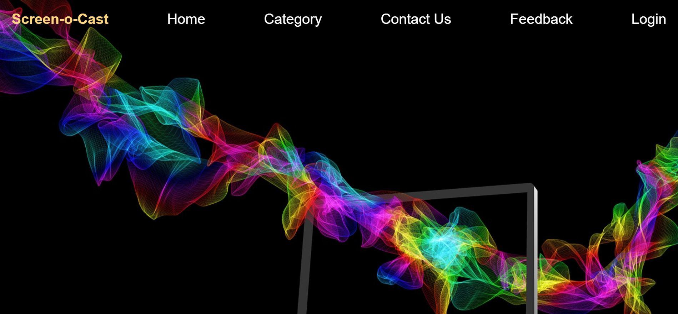
Home

Slide 6
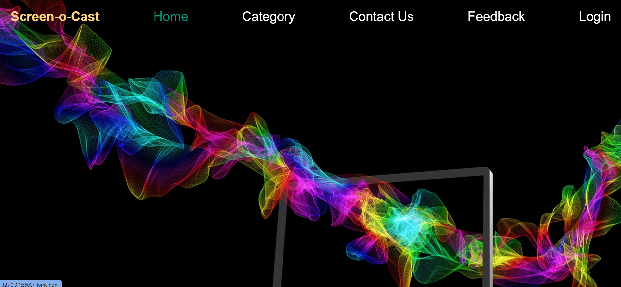
Button-hover feature

Slide 7
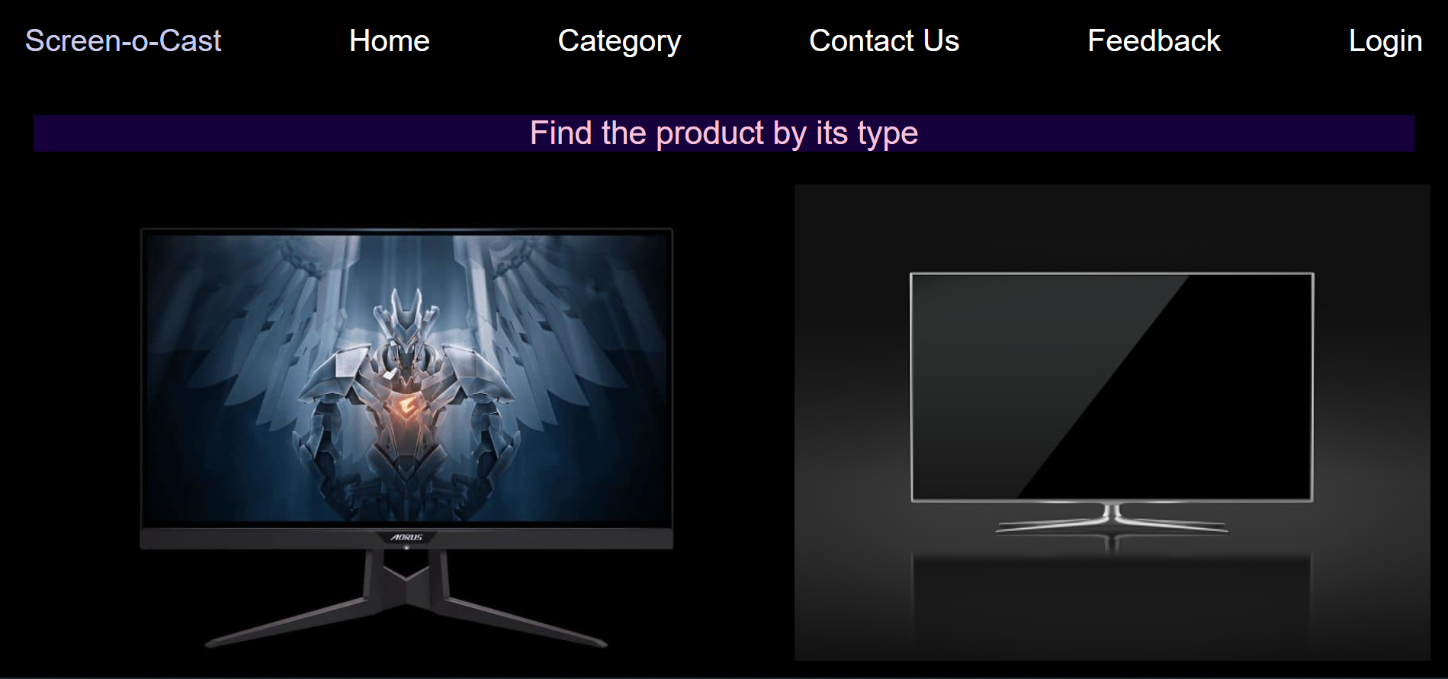
CATEGORY

Slide 8
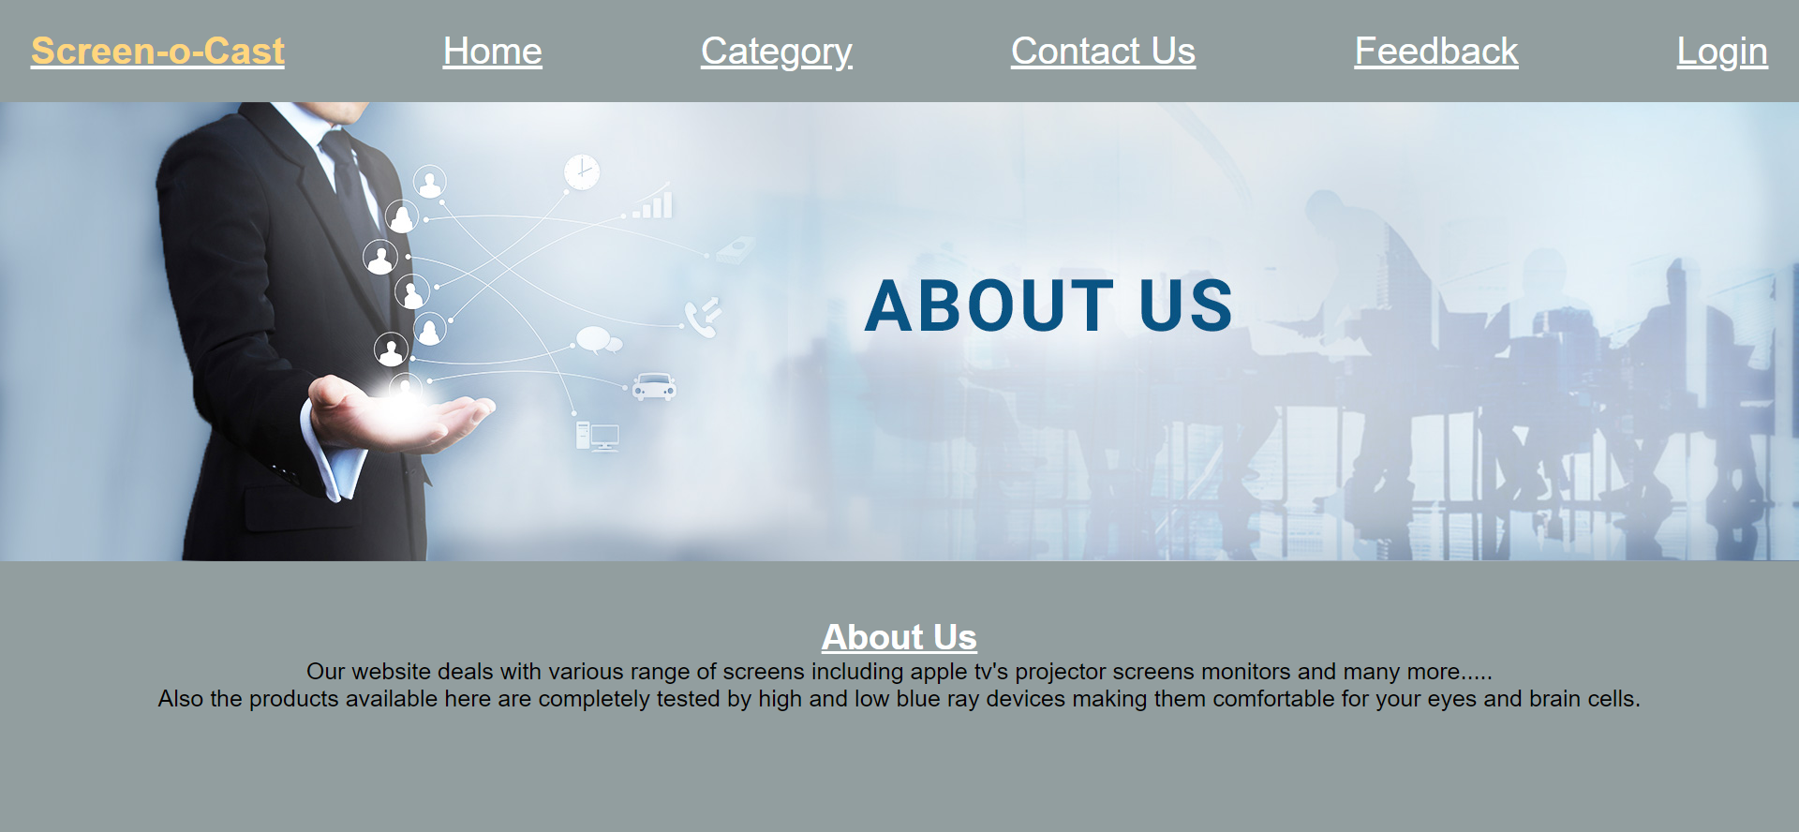
About Us

Slide 9
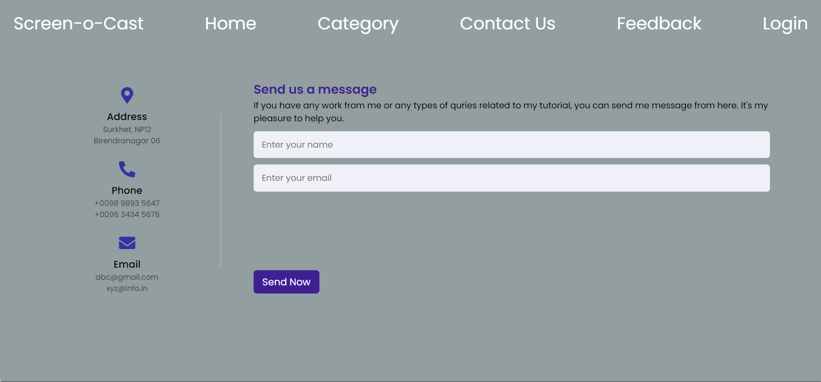
CONTACT US

Slide 10
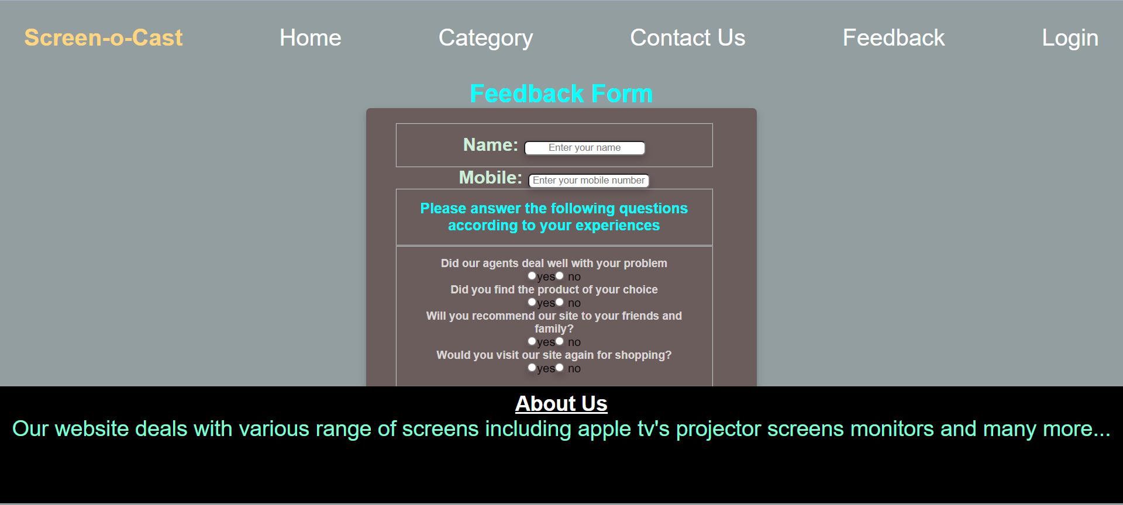
Feedback

Slide 11
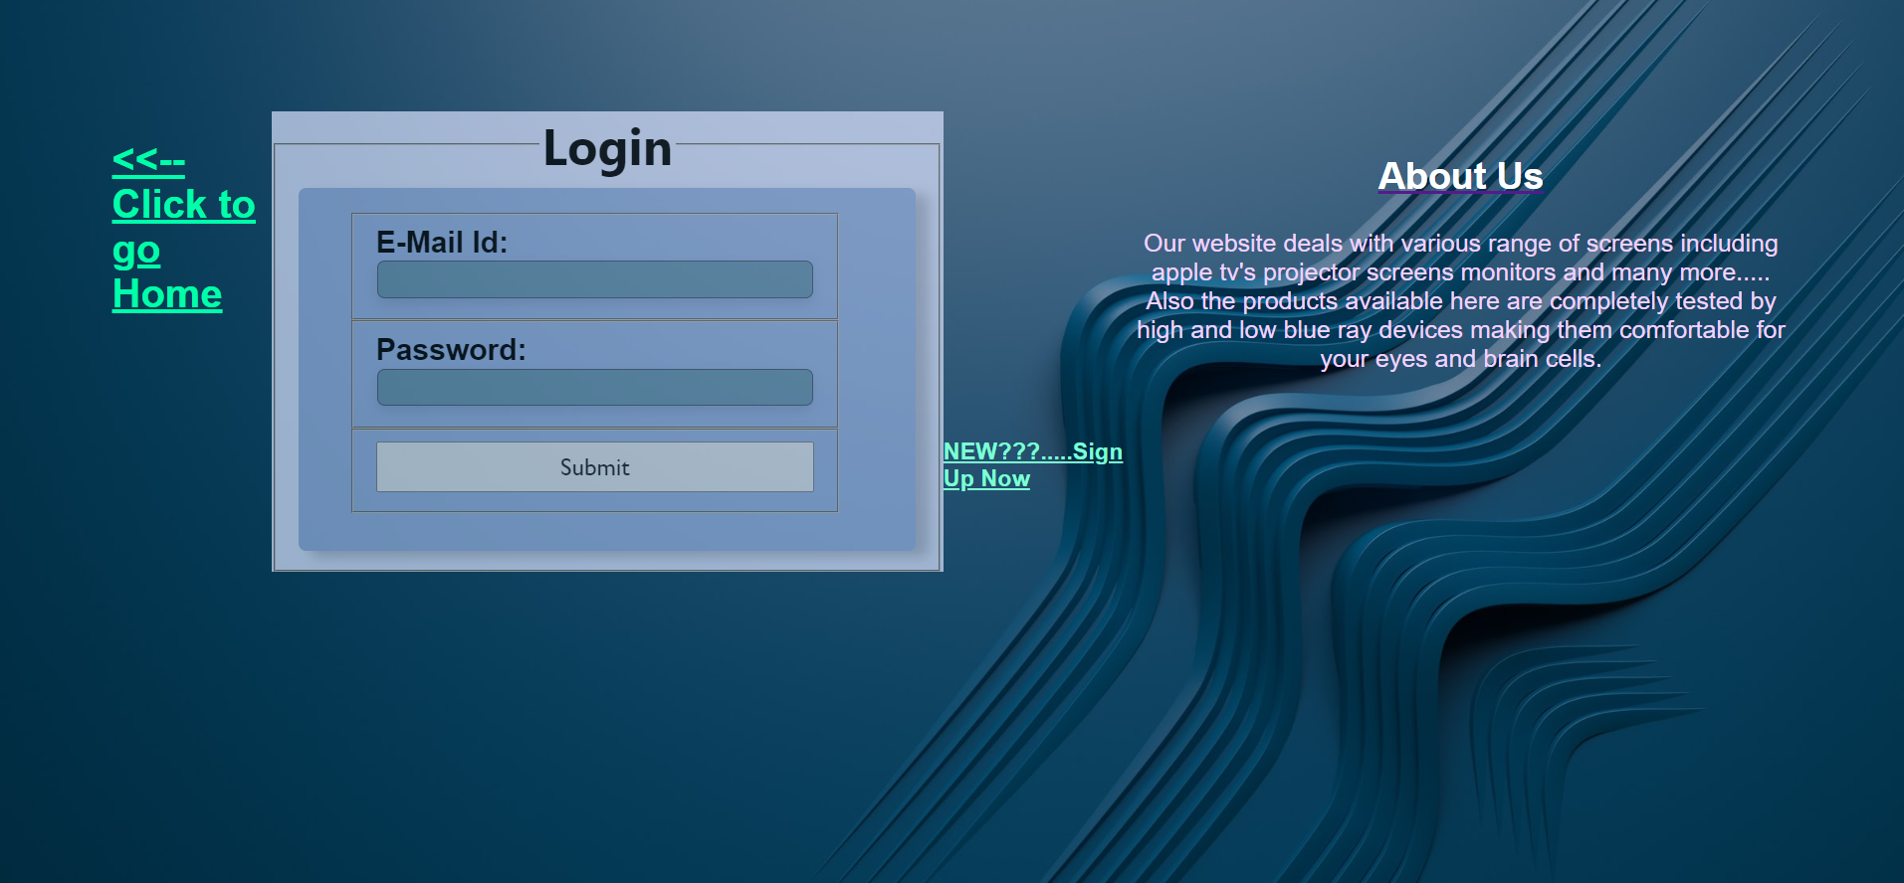
LOGIN

Slide 12
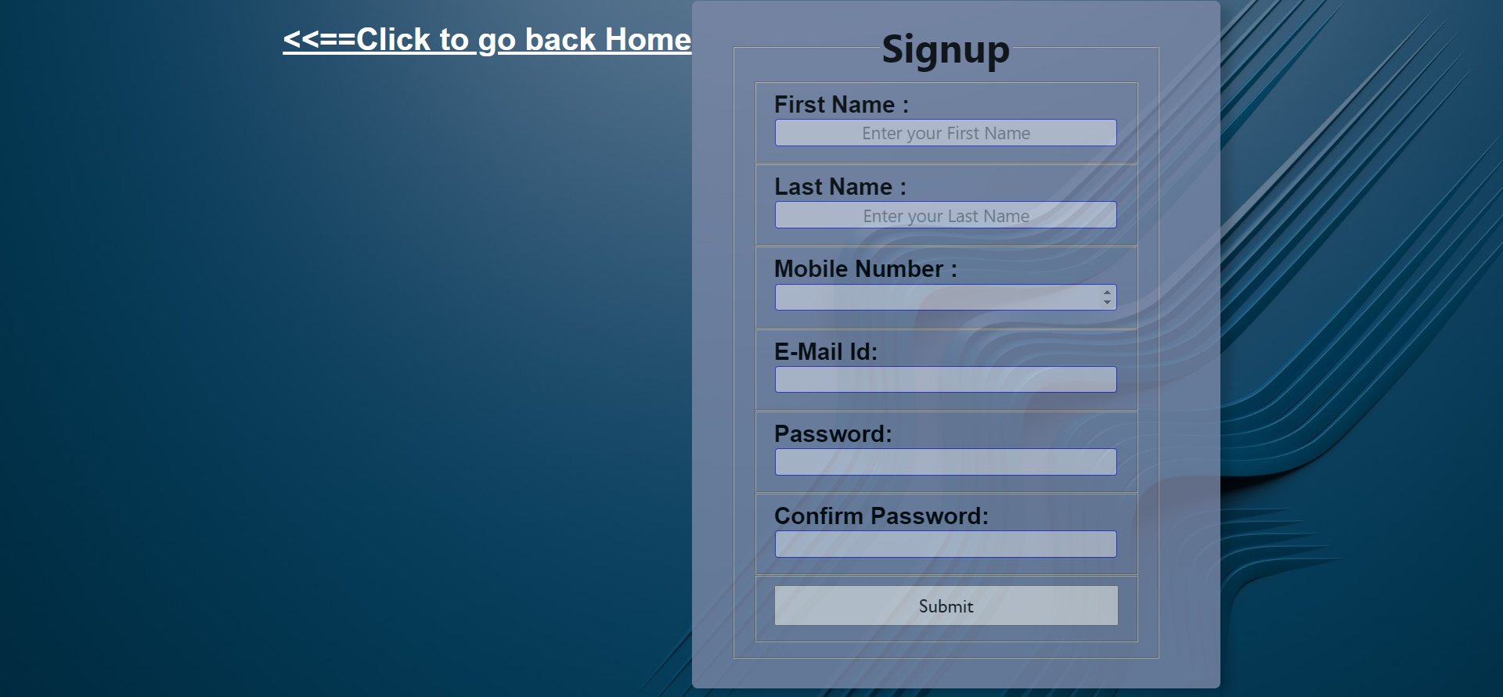
Sign-Up

Slide 13
Future Vision
The upcoming features may include website linking to other major businesses and expanding its reach over various servers in the world of web
Also the future vision of our company makes us clearly hoping for more and more use of tags and styling objects
Different more languages like react, bootstrap, css3 would be implemented making the designing of the website more attractive and user-friendly.

Slide 14
Bibliography
www.google.com
www.geeksforgeeks.com
www.unsplash.com
www.pixabay.com
www.flipkart.com
www.amazon.com

Slide 15
Thank You
Jai Arora
G17
2010991894

